Slide 1
Reflective, verbally competent mathematicians
How can we help to develop them?

Slide 2
Why is it important?
Maths is a language all of it’s own
Eg: What is the difference between these numbers?
Lets make a bank of other terms which mean something different in the world of maths
23
18
and

Slide 3
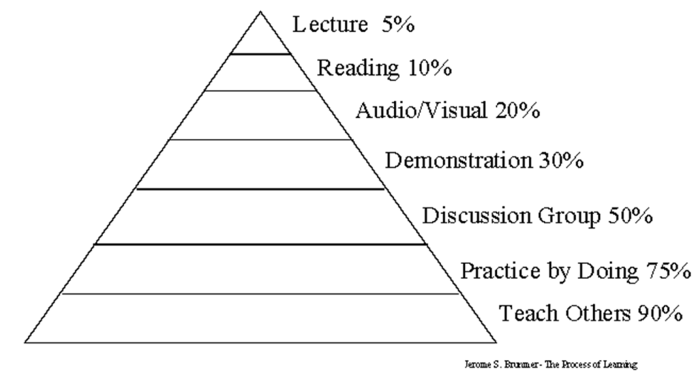
Why is it important?
Explaining to others is the best way of learning.
Explaining is impossible without the sentence structures and vocabulary needed.

Slide 4
Tools required…
Understand the structure of an effective explanation (modelling and scaffolds)
Have a working understanding of mathematical concepts (regular use of definition)
The ability to use what something is and what something is not to explain.

Slide 5
Scaffolds should…
Not be procedural (usually). If children are explaining what they did, they are not really using this time as profitably as they could.
Be specific. They should allow children to hone in on one part of the learning and explain.
Be a chance to say what didn’t work as often as what did. This is often a far richer task.
Be modelled regularly.
Be flexible. Plan them but be ready to change them when the course of the learning throws up an opportunity.

Slide 6
Scaffolds
KS2 – sort the scaffolds in to mathematically supportive and mathematically weak. Think about how to improve the weak ones
KS1 – take the scaffold and think about how to make it small person friendly. (Think evidencing without too much stress or extra work)

Slide 7
Homework
Shared write a definition for your maths wall related to something you are learning this week. Even if it is a very familiar topic I think we will be surprised.
Try out a new scaffold this week.
Try to think what you are expecting that scaffold to allow the children to do.

