Slide 1
Learning through the lens of disadvantaged pupils
Maximising the impact of the Pupil Premium
Camden Conversation
Marc Rowland
January 2022

Slide 2
A
School culture, expectations, relationships, leadership capacity.
B
Assessment of need:
what are the controllable factors that impact on disadvantaged pupils' learning?
C
How do we address disadvantage in the classroom, through academic intervention and wider approaches?
D
How does research evidence support the approach(es)?
E
How will we ensure it is implemented well?
What system wide support can we draw on?
F
What milestones will tell us we are on track?
G
What is the intended impact?
Developing an effective strategy…
Template Section A
Template Sections A & B
Intent statement & principles
Challenges to learning
Teaching Intervention
Wider App
Research evidence to inform
Review of outcomes / further info
Intent, Intended outcomes and success criteria / Further info

Slide 3
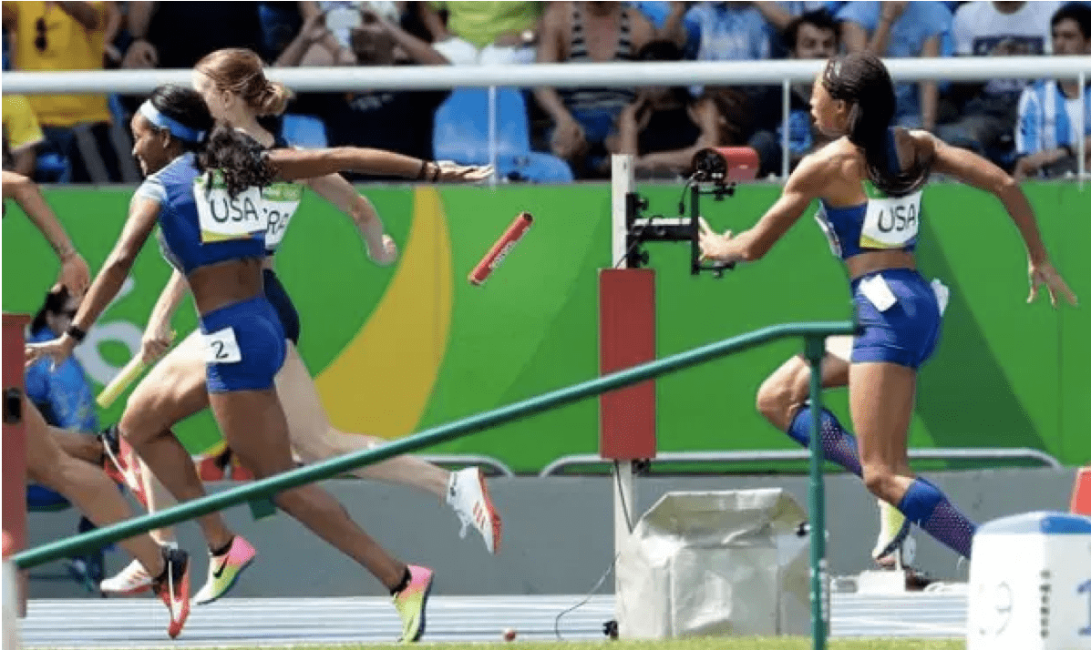

Slide 4
Helping disadvantaged pupils feel like they belong in the classroom
Imagine being in a new city abroad. You don’t speak the language. You don’t know your way
around. Conversely, everyone else around you seems to be contently going about their daily business.
For many disadvantaged children, this is what the classroom feels like.
How can we foster a sense of belonging for our disadvantaged pupils?
Level the playing field - Empower all pupils with key knowledge at the very beginning of lessons.
Scaffold oracy and discussion - Use sentence stems or collaborative group work for all pupils. This will make disadvantaged learners feel safe and secure but also challenged.
Have clear routines and structures - All pupils feel safe and secure when the are confident they know what’s coming.
Plan the curriculum carefully - Is the curriculum relevant, challenging and based on previous learning?
Set pupils up for success - There should be plenty of opportunities to feel successful and
fewer opportunities to feel like an outsider. Receiving meaningful praise from an adult will improve self-esteem and promote future engagement.
Feedback – See feedback through the lense of the pupil. Is the feedback timely and relevant?

Slide 5
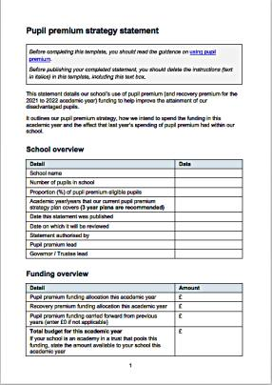
The first ‘overview’ section is just about basic information about the school.
Note the merging of recovery and Pupil Premium together, encouraging a coherence around additional funding.
Note the removal of end of key stage 2 / 4 performance data and encouraging of schools to take a long term approach.

Slide 6
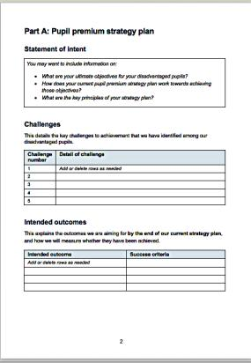
The statement of intent is an opportunity for schools to tell their story, beyond simplistic data. The key questions are listed on the document.
But for me this is about explaining to both internal and external stakeholders about our ambitions, how we aim to achieve them and what are our underpinning values and principles. The ‘intent’ is something that all school staff should understand at a strategic level, and what their individual roles are making a reality.

Slide 7
‘If you expect nothing from somebody you are never disappointed.’
Sylvia Plath
‘The least dangerous assumption is that they [pupils] can do it!’
Edith Borthwick Special School, Essex

Slide 9
Discussion for SLT:
Have we secured a inclusive culture?
Have we secured a culture of high expectations for disadvantaged pupils?

Slide 10
Relationships matter
Relationships as drivers of human development: Positive supportive contexts
Osher et al, 2019
Relationships between and among children and adults are a primary process through which biological and contextual factors influence and mutually reinforce each other. Relationships that are reciprocal, attuned, culturally responsive, and trustful are a positive developmental force between children and their physical and social contexts.
Such relationships help to establish idiographic developmental pathways that serve as the foundation for lifelong learning, adaptation, the integration of social, affective, emotional, and cognitive processes and will, over time, make qualitative changes to a child’s genetic makeup.
Bornstein & Leventhal, 2015; Bronfenbrenner & Morris, 2006.

Slide 11
Bias
‘You see what you expect to see, Severus’
JK Rowling

Slide 12
The change from ‘barriers’ to challenges is important. It is beyond semantics. It is important to avoid always framing disadvantage as a deficit model. As stated above, it is vital that assessment, not assumption drives approaches. Disadvantage goes beyond Pupil Premium eligibility.
Poorly identified challenges lead to poorly identified activity, leading to weaker outcomes for pupils and sometimes in initiative fatigue around address disadvantage. It leads to the ‘supermarket sweep’ approach to disadvantage grabbing intervention for Y6 / Y11. Early intervention focussed on need enables pupils to thrive in school.
Look to be as precise as possible. Centre in on the key things that are preventing disadvantaged pupils from attaining as well as they might. Academic and pastoral issues should be included. Developing pupils’ oral language and reading comprehension is often at the heart of an effective strategy.
‘Many of our pupils eligible for Pupil Premium have additional vulnerabilities (e.g. SEND)’. Whilst these may be characteristic of pupils at risk of underachievement, it is important to unpick the actual issues that are most preventing disadvantaged pupils from attaining well. Pupils are not at risk of underachievement because they are SEND – rather, there needs to be careful consideration how additional needs are impacting on learning e.g. autism and anxiety.

Slide 13
‘Be an expert in your pupils, not labels’
How does socio economic disadvantage impact on pupils’ learning [in OUR school]?
What are the controllable factors that impact on disadvantaged learners?
What issues are MOST preventing disadvantaged pupils from attaining well?
A learning led approach, not a label led a approach

Slide 14
1
Being wary of a deficit discourse around disadvantage. Focus on what’s in our gift.
2
3
4

Slide 15
Diagnostic Assessment

Slide 16
Questions for leaders…
Of the challenges you have identified, which are having the biggest impact on pupil outcomes?
How can you make sure that challenges you focus on are a) precise b) manageable?
How are you ensuring that activity tightly links to challenges?
How well does evidence support that activity?

Slide 17
Intended outcomes are determined before activities. Experience tells us the level of resource and expertise needed to address disadvantage is often underestimated, especially when we don’t clearly define intended outcomes.
Well defined success criteria are key to good / dispassionate impact evaluation. Decouple impact evaluation from accountability. Vague success criteria make it easier to claim success. Remember that colleagues involved in the implementation of an approach are not always the best judges of success. Be wary of activity being mistaken for outcomes.
The intended outcomes link should closely to the challenges pupils face.
It is important to be mindful of success criteria that are actually activities. For example: ‘Learning Support reports are produced as soon as possible for children that need them. The information in the reports is shared with parents and used to plan in class (and small group) activities and interventions.’

Slide 18
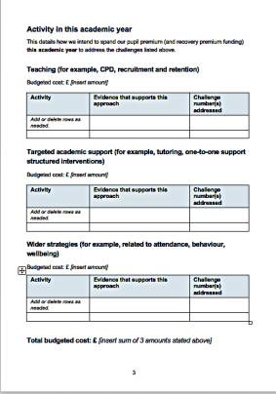
The activity section uses the EEF’s tiered model. There is no longer any need to list the individual costs of activities, just the budget associated with each tier.
Schools should link activities with challenges and ensure that activity is informed by research evidence that it may be effective. It is important to remember that research evidence can only point us in the right direction. We should use it to inform our decision making, not justify it.
Evidence we can use goes beyond the EEF toolkit and may include small, in school experiments as well as meta-analysis and RCTs.

Slide 19
What issues are being addressed?
How do we know they are being addressed?

Slide 20
‘It’s just quality first teaching…’
No!
Vessels Moored off a Jetty National Gallery, London
Artist | Jan van de Cappelle
Artist dates | 1626 - 1679

Slide 21
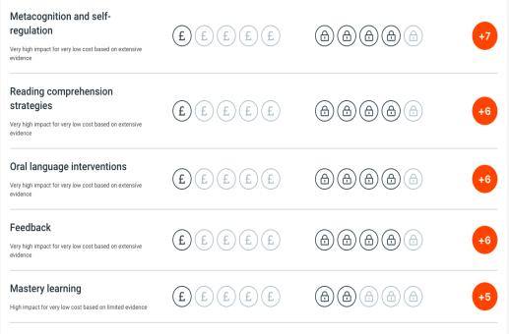
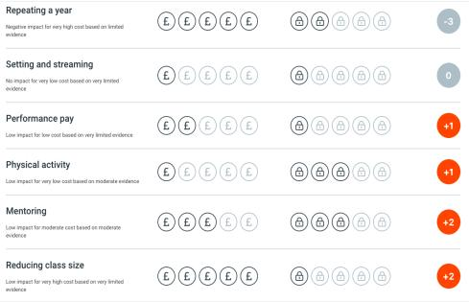
Discussion!
What are the best bets, given our understanding of the needs of our pupils?

Slide 22
Vocabulary at aged five
There is a 27% gap between the lowest income quintile and the highest.
The lowest quintile have 16% more likely to have conduct problems compared to the highest quintile.
The lowest quintile are 15% more likely to have hyperactivity problems compared to the highest quintile.
Waldfogel and Washbrook, 2010

Slide 23
Selecting the ‘right’ words to teach
Be specific when teaching vocabulary.
A scattergun approach is counter-productive.
Don’t overload pupils with vocabulary.
Carefully consider the words you teach – and teach them deeply.
Tier Two words are proven to be the most useful…
‘Tier One’ words – Simple and familiar e.g. Bike, happy, ball
‘Tier Three’ words – Specific to a particular discipline e.g.
Chromosome, Mesozoic
‘Tier Two’ words – Highly useful, appear primarily in print, and are likely to appear in multiple contexts or with varying
meanings e.g. chameleon, siege, catharsis

Slide 24
Using the SEEC Model
Select - Tier Two words relevant to lesson.
Explain -
What does destitute mean?
Learning Time
Definition
Describe a situation in which a rich person may become destitute.
Definition
Learning Time
Explore - Synonyms, antonyms, etymology
Consolidate - e.g. write a sentence using the words ‘because’ and ‘destitute’.

Slide 25
Explicit Vocabulary Instruction Example – HISTORY
Word | Definition | Related words | Sentence | Image
Astonished Adjective | Greatly surprised or impressed: amazed | Astonishing (Adjective) | Many were astonished by Henry VIII’s actions.
Avaricious Adjective | An extremely strong wish to get or keep money or possessions | Greed (Synonym) (noun) | Even though the King had all the riches in the world, this avaricious leader always wanted more.
Seized Verb | Take hold of something suddenly and forcibly | Seize (Present tense verb) | Henry seized his chance.
11

Slide 26
Reading improves teenagers’ vocab, whatever their background, say researchers
22 November 2017
Teenagers who read in their spare time know 26 per cent more words than those who never read, according to researchers at the Centre for Longitudinal Studies (CLS).
The research team, based at the UCL Institute of Education, found that teenagers who read often, and those who had access to plenty of books, were more likely to develop a better vocabulary than their peers.
Analysing the scores of nearly 11,000 14-year-olds in a word exercise, the researchers found that teenagers who read for pleasure every day understood 26 per cent more words than those who never read at all in their spare time. And teenagers from book-loving homes knew 42 per cent more words than their peers who had grown up with few books.
Even taking into account other factors, like parents’ qualifications and profession, and cognitive tests taken by the teenagers when they were aged 5, teenagers who read for pleasure still got 12 per cent more words right, while those from book-rich homes scored 9 per cent more.
https://cls.ucl.ac.uk/reading-improves-teenagers-vocab-whatever-their-background-say-researchers/

Slide 27
Children persist less when adults take over: https://pubmed.ncbi.nlm.nih.gov/33484166/ Metacognitive awareness inventory: https://services.viu.ca/sites/default/files/metacognitive-awareness-inventory.pdf
Metacognition and Self regulated learning

Slide 28
Questions for school leaders: How are we:
Addressing the presumption of language?
‘Repetition’
2. Addressing the presumption of background knowledge?
‘Dunkirk… was he British?’
3. Addressing the presumption of learning behaviours?
‘What... I can ASK for revision flash cards?’
‘
This is about the experiences of pupils day in day out in school…

Slide 29
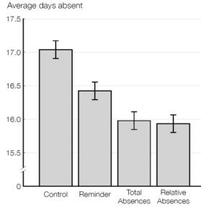
Small changes matter
How do parents know what poor attendance is?
RCT in 203 schools shows if given more (better) information parents act differently.
Absences matter and how you can help!
https://leadinglearner.me/2017/07/02/absences-matter-and-you-can-help/
Notes:
72% of parents with higher-than-average-absence students did not know that their children had missed more school than their classmates. When informed they make extra efforts to improve attendance.
In a randomised controlled trial in 203 American schools, sending a letter to parents stating the total number of days their child had been absent led to an average reduction in absences of one day per child (versus no letter).
The study showed that the wording of the letter matters: a simple reminder of the importance of attendance helps a little, but the crucial piece of information was personalising the letter to give the total number of absences to date.
Example of a targeted approach: send letters to those with above average absences

Slide 30
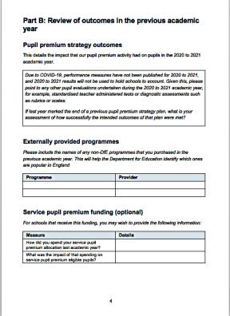
The review of outcomes section is about reflecting on the effectiveness of our ongoing strategies. We might adjust and change approaches based on ongoing evaluation. This is fundamental to better long term outcomes for pupils.
Remember that a number of planned strategies might not have been fully implemented due to Covid 19 restrictions and partial school closures. Resources were often diverted to support acute and unplanned need arising from the pandemic.

Slide 31
When evaluating impact, do: - Focus on whether activity has been successful, and in what circumstances. Evaluate, don’t prove. - Look for evidence of impact on pupil outcomes - Put in place a robust evaluation framework at the start of the strategy. Set milestones. - Ensure that the evaluation framework is transparent. Set out in advance. - Report on progress against that framework. With governors. - Judge our success based on outcomes for disadvantaged pupils, not institutions. Pupil outcomes > Ofsted grades
- Decouple evaluation from accountability. When evaluating impact, don’t: - Base evaluation of improvement on the weakest datasets, in order to can claim credit for any small improvements. - Base evaluation of improvement on the reactions of those delivering the plan. - Base evaluation of improvement on selected schools that were the most enthusiastic about the plan. - Use vague outcome measures from the start, making success easier to claim. - Use one set of favourable data or ignore any negative findings: avoid ‘X% of pupils didn’t attain well as they have SEND’. - Use sets of data that avoid focusing on pupil learning outcomes. Evaluation is fundamental to continuous improvement and to building a solid evidence base that will enable the plan to impact on pupils.

Slide 32
This final further information section links to the initial intent statement. It looks to help school leaders to articulate how their strategies are evolving, adapting and changing over time. Anyone who visits a school to learn about their Pupil Premium strategy will see a ‘still from a reel of film’. This section helps to add to that. Again, to tell the story of the school and its evolving approach to disadvantage. This is important as our knowledge about how best to do this improves all the time.
Five years ago, label led / accountability led approaches were common. The most exciting change for our disadvantaged pupils, and those that work with those pupils is that schools are focusing on the controllable factors impacting on learning in ever greater numbers. This is key to success.

Slide 33
So finally…
Improve pupils as learners. Don’t try to ’middle classize’ pupils
High expectations are fundamental
Assessment not assumptions
Learning led, not label led approaches
Intervene early, consider trade offs
Secure a collective responsibility
Avoid bias
Consistency and quality of relationships matter. Classroom interactions are key.
Address the language gap
Reading is key to success
Avoid a deficit discourse around disadvantage. Issues may not always lie with pupils and families
Give teachers the support, knowledge and skills to meet the needs of disadvantaged pupils
See life through the lens of disadvantaged pupils
Decouple evaluation from accountability. Evaluate don’t prove.

Slide 34
From
‘What are the problems with our disadvantaged pupils?’
‘How can we better include ALL of our pupils in school life and challenging learning?’
to
Shifting our thinking. Life through the lens of our disadvantaged pupils…

Slide 35
New EEF Pupil Premium guide
https://d2tic4wvo1iusb.cloudfront.net/documents/guidance-for-teachers/pupil-premium/EEF-Guide-to-the-Pupil-Premium-Autumn-2021.pdf
New DfE reporting template examples
https://www.gov.uk/guidance/pupil-premium-effective-use-and-accountability?utm_medium=email&utm_campaign=govuk-notifications&utm_source=b4adf541-95ad-41a1-88c8-8f99c2fa52a3&utm_content=daily#strategy-statement-templates
TES Interview
https://www.tes.com/news/what-pupil-premium-template-examples-mean-schools

Slide 36
Senior Leaders
https://marcrowland.files.wordpress.com/2019/11/oldham-and-derby-report.pdf
https://vimeo.com/537159174/9dcffaf80a
https://www.youtube.com/watch?time_continue=4&v=J_6YinTpTtI&feature=emb_logo
https://researchschool.org.uk/sandringham/news/what-makes-the-difference-for-our-disadvantaged-pupils
https://researchschool.org.uk/durrington/news/tackling-educational-disadvantage-2
https://researchschool.org.uk/durrington/news/addressing-the-catch-up-conundrum
https://bromleyeducationmatters.uk/Page/19294
https://podcasts.apple.com/gb/podcast/episode-1-pupil-premium-with-marc-rowland/id1516020856?i=1000476461565
https://cyps.northyorks.gov.uk/sites/default/files/School%20improvement/2017%2018%20Achievement%20Unlocked%20Summary%20Update%20Report%2025.6.18.pdf

Slide 37
Teachers & MLT
https://classteaching.wordpress.com/2022/01/17/planting-the-roots-for-vocabulary-growth/
https://www.tes.com/magazine/teaching-learning/eyfs/why-early-language-matters-mental-health
https://www.theguardian.com/books/2019/mar/09/why-reading-aloud-is-a-vital-bridge-to-literacy
https://www.tes.com/magazine/teaching-learning/eyfs/why-shared-reading-must-be-early-priority
https://researchschool.org.uk/greenshaw/news/through-the-lens-of-disadvantage
https://researchschool.org.uk/durrington/news/responsive-teaching-in-turbulent-times
And SO much more…

Slide 38
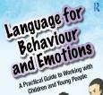
Addressing the language gap
http://thinkingtalking.co.uk/finding-a-word-aware-or-language-for-thinking-course/
http://thinkingtalking.co.uk/finding-a-word-aware-or-language-for-thinking-course/
https://impact.chartered.college/article/beck-deepening-knowledge-through-vocabulary-learning/
My wonderful colleagues at Durrington Research School have produced a series of videos on evidence informed practices. They are 30 minutes long, covering a range of pertinent issues such as:
Explicit vocabulary instruction
Improving writing
Improving memory
Disciplinary reading
Structured classroom talk
Feedback
Cognitive load theory
And more…! You can find the videos here: https://researchschool.org.uk/durrington/events/videos

Slide 39
mrowland@unitysp.co.uk
@marcrowland73
https://marcrowland.wordpress.com/
https://researchschool.org.uk/unity/

